Slide 1
SEQSUMM: Sequence Summarize with Transformer
Project Advisor: Simon Shim
Team Members: Gunjal Gupta
Heli Sanjaykumar Patel
Leonid Grekhov
Shaunak Anirudha Bhatlawande

Slide 2
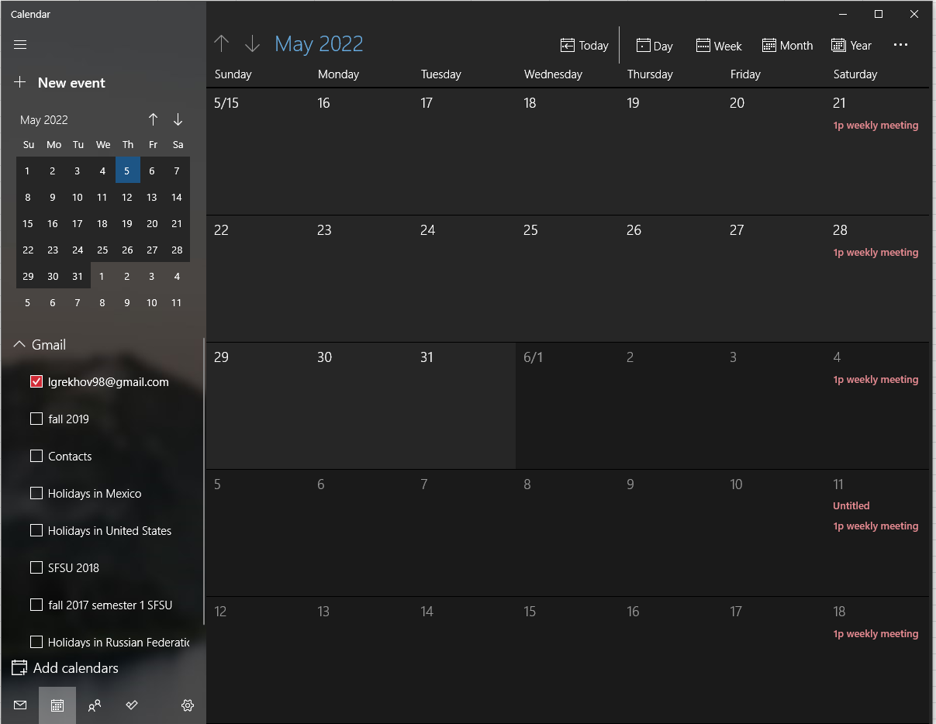
GAN research
Gunjal and Heli familiarize themselves with basic machine learning https://youtu.be/tPYj3fFJGjk + previous homework assignments
GAN research
Gunjal and Heli familiarize themselves with basic machine learning
GAN
research
Gunjal and Heli familiarize themselves with basic machine learning
Transformer research
Gunjal and Heli familiarize themselves with NLP
Transformer research

Slide 3
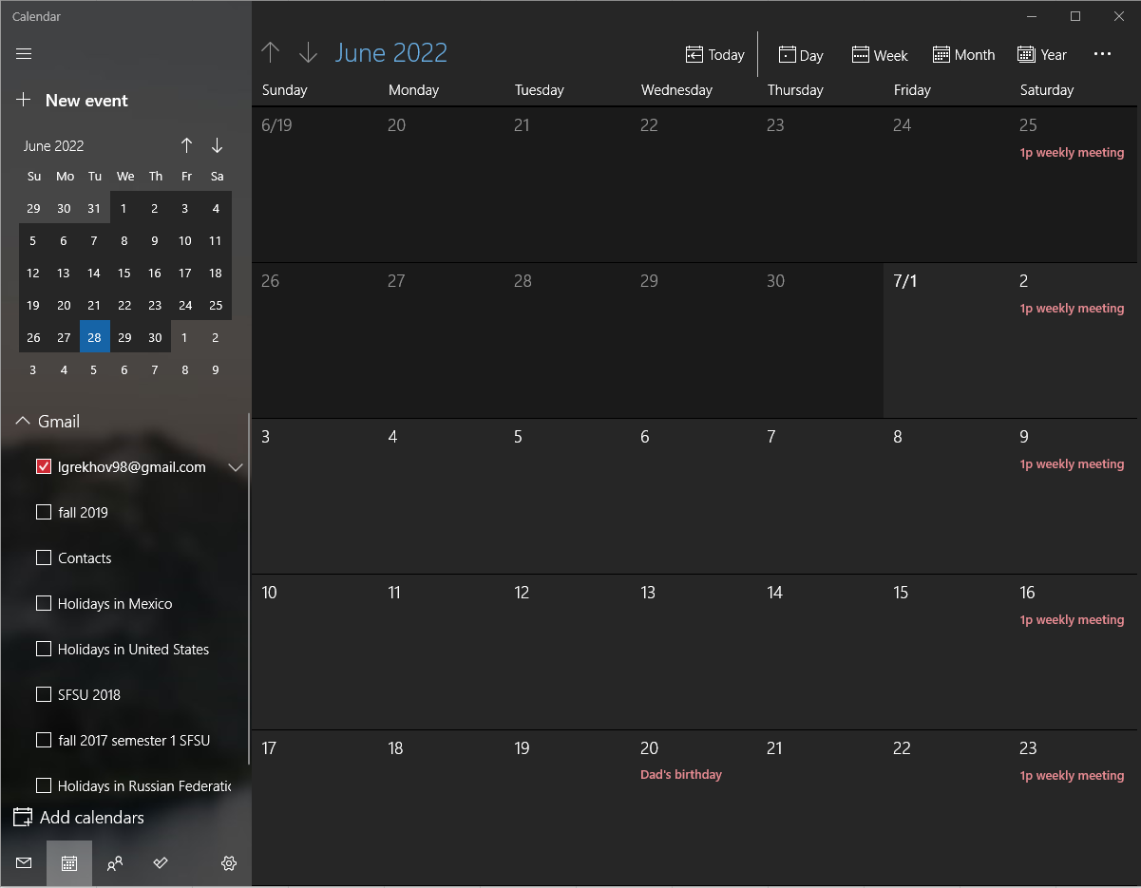
Transformer research
Gunjal and Heli familiarize themselves with NLP
Transformer research
Gunjal and Heli familiarize themselves with NLP
GAN and transformer network testing
Gunjal and Heli familiarize themselves with NLP
GAN and transformer network testing
Gunjal and Heli familiarize themselves with NLP
GAN and transformer network testing

Slide 4
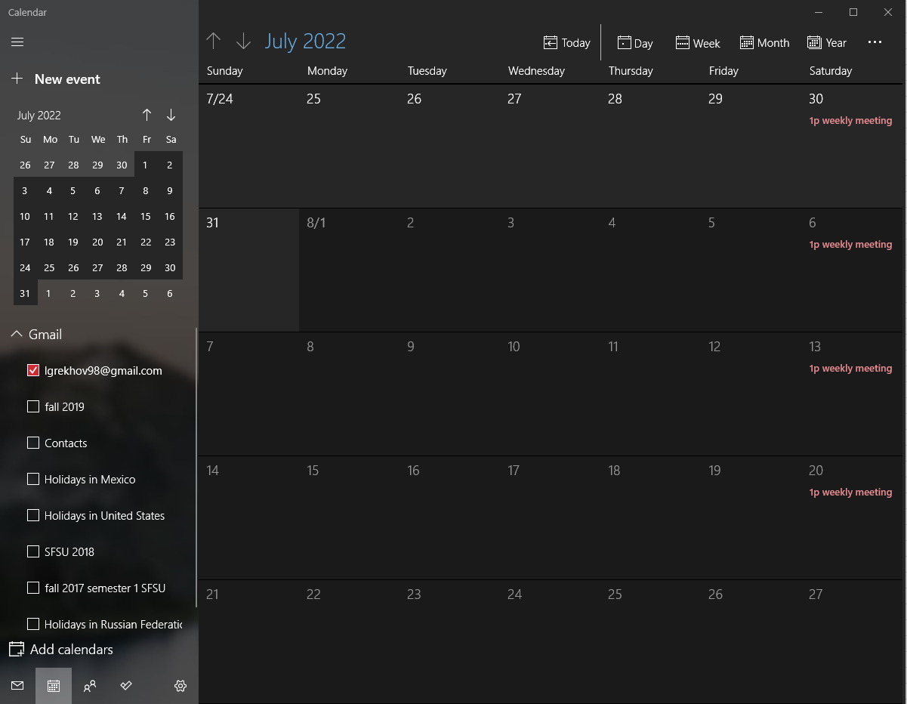
Gunjal and Heli assist with machine learning network
GAN and transformer network testing
Gunjal and Heli work on web implementation
Web implementation of machine learning code
Gunjal and Heli work on web implementation
Web implementation of machine learning code
Gunjal and Heli work on web implementation
Web implementation of machine learning code

